Slide 1
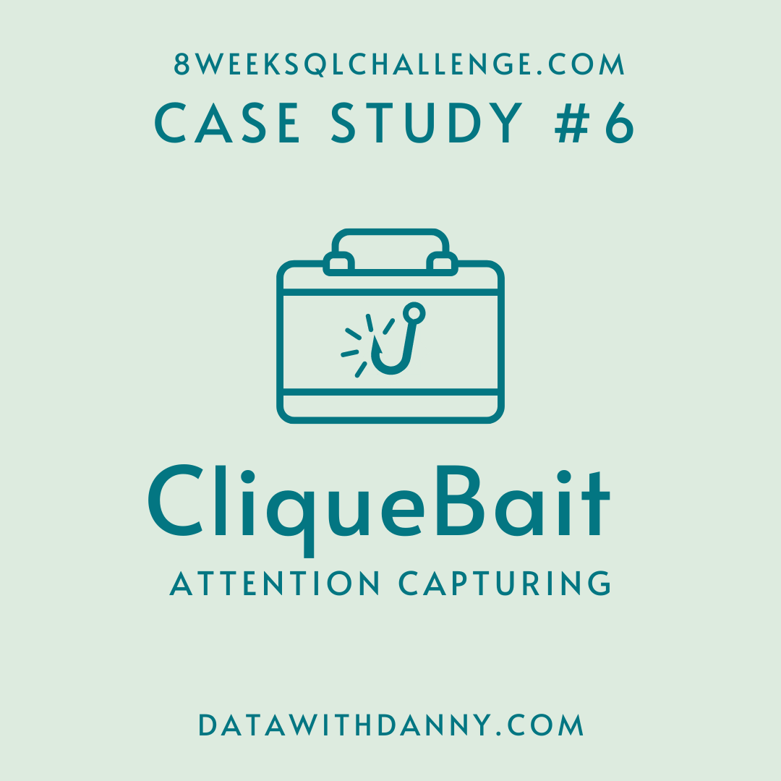
8 Week SQL Challenge
Case Study #6 Clique Bait

Slide 2
Introduction
Clique Bait is not like your regular online seafood store - the founder and CEO Danny, was also a part of a digital data analytics team and wanted to expand his knowledge into the seafood industry!
In this case study - you are required to support Danny’s vision and analyse his dataset and come up with creative solutions to calculate funnel fallout rates for the Clique Bait online store.

Slide 3
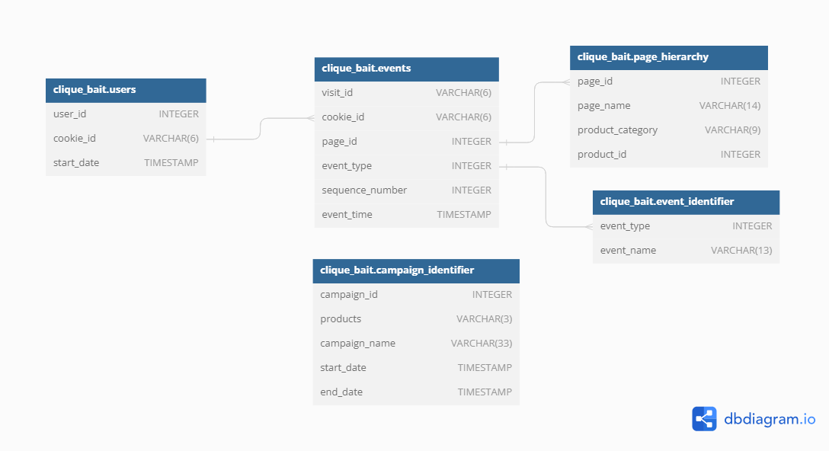
Case Study Questions
Enterprise Relationship Diagram

Slide 4
2. Digital Analysis
How many users are there?
How many cookies does each user have on average?
What is the unique number of visits by all users per month?
What is the number of events for each event type?
What is the percentage of visits which have a purchase event?
What is the percentage of visits which view the checkout page but do not have a purchase event?
What are the top 3 pages by number of views?
What is the number of views and cart adds for each product category?
What are the top 3 products by purchases?

Slide 5
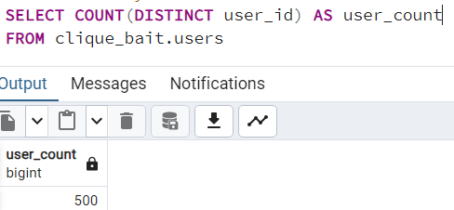
1. How many users are there?

Slide 6
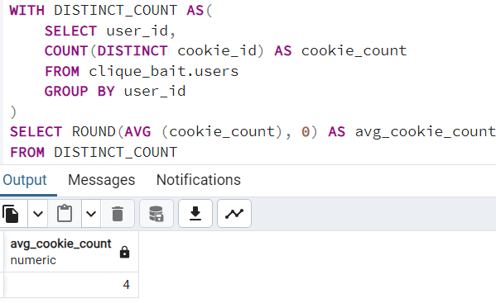
2. How many cookies does each user have on average?

Slide 7
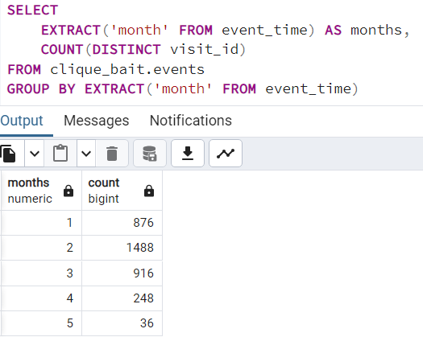
3. What is the unique number of visits by all users per month?

Slide 8
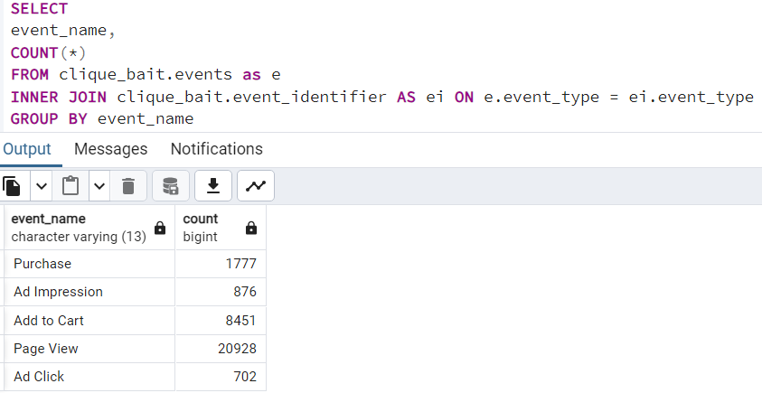
4. What is the number of events for each event type?

Slide 9
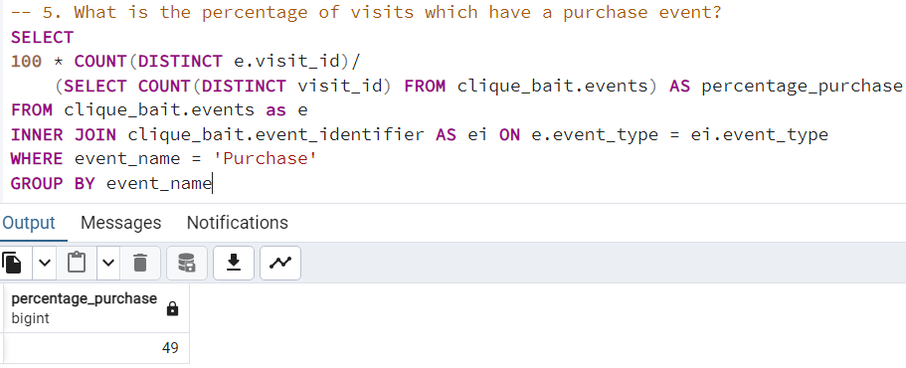
5. What is the percentage of visits which have a purchase event?

Slide 10
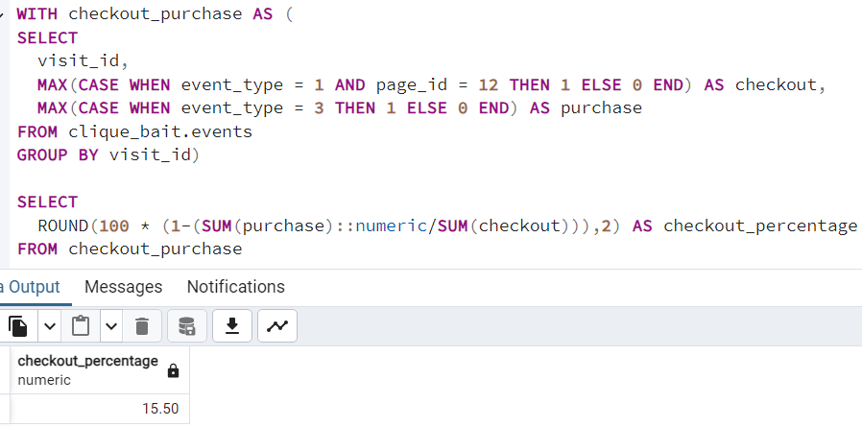
6. What is the percentage of visits which view the checkout page but do not have a purchase event?

Slide 11
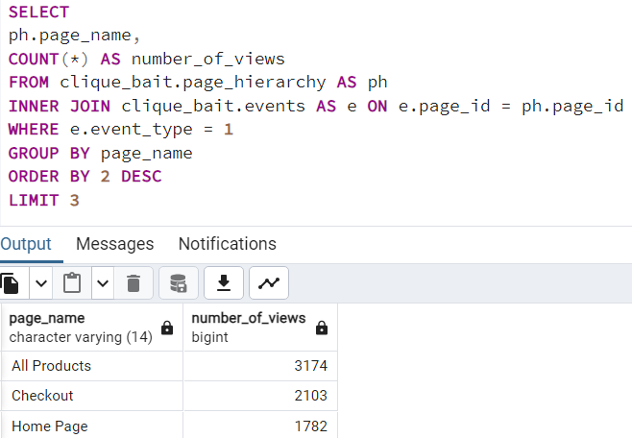
7. What are the top 3 pages by number of views?

Slide 12
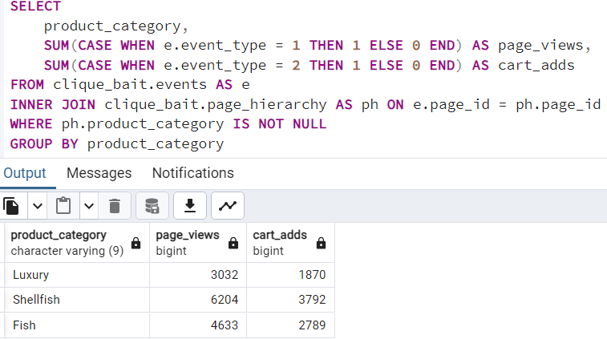
8. What is the number of views and cart adds for each product category?

Slide 13
3. Product Funnel Analysis
Using a single SQL query - create a new output table which has the following details:
How many times was each product viewed?
How many times was each product added to cart?
How many times was each product added to a cart but not purchased (abandoned)?
How many times was each product purchased?
Additionally, create another table which further aggregates the data for the above points but this time for each product category instead of individual products.
Use your 2 new output tables - answer the following questions:
Which product had the most views, cart adds and purchases?
Which product was most likely to be abandoned?
Which product had the highest view to purchase percentage?
What is the average conversion rate from view to cart add?
What is the average conversion rate from cart add to purchase?

Slide 14
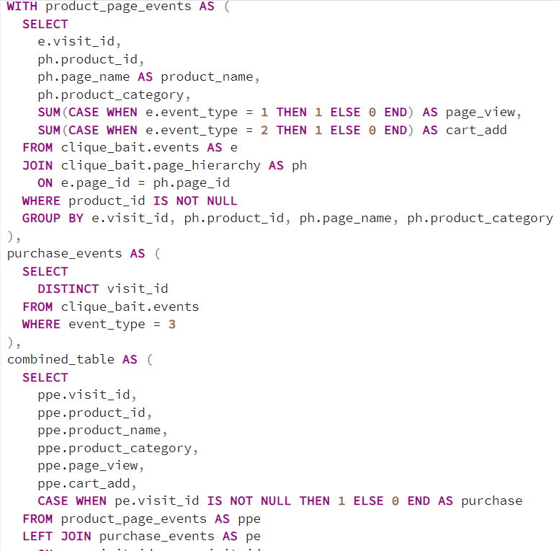
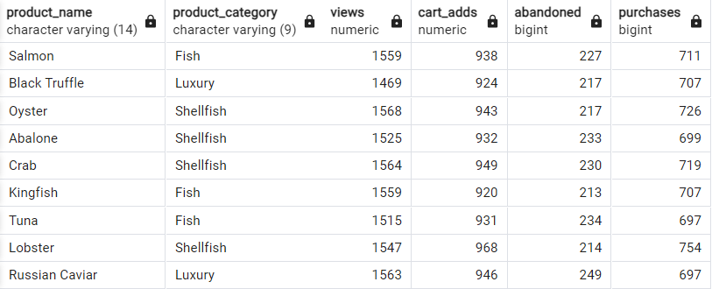
SOLUTION 1

Slide 15
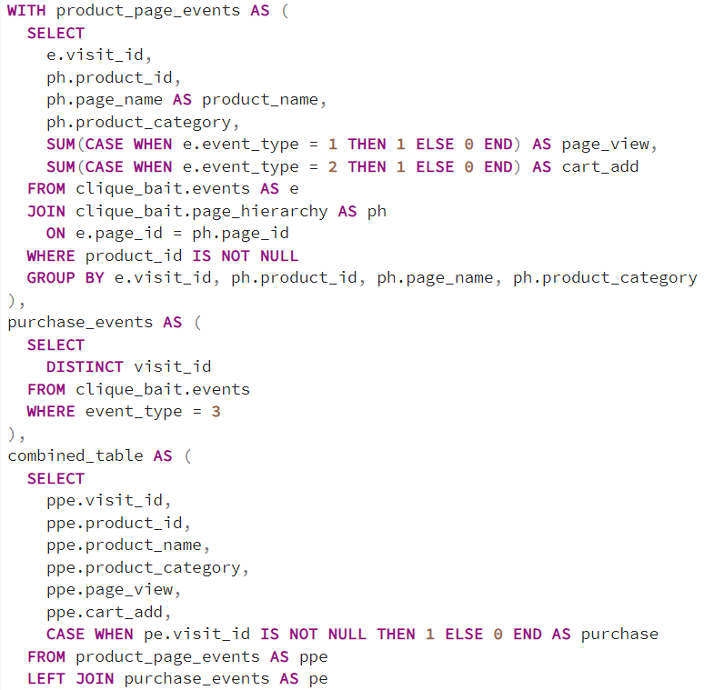
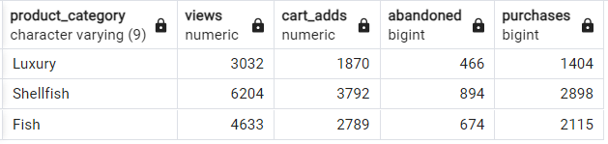
SOLUTION 2

Slide 16
1. Which product had the most views, cart adds and purchases? 2. Which product was most likely to be abandoned?
Most viewed Product is Oyster
Product with most number of cart adds is Lobster
Product which was purchased the most is Lobster
Product which is Most likely to be abandoned is Russian Caviar

Slide 17
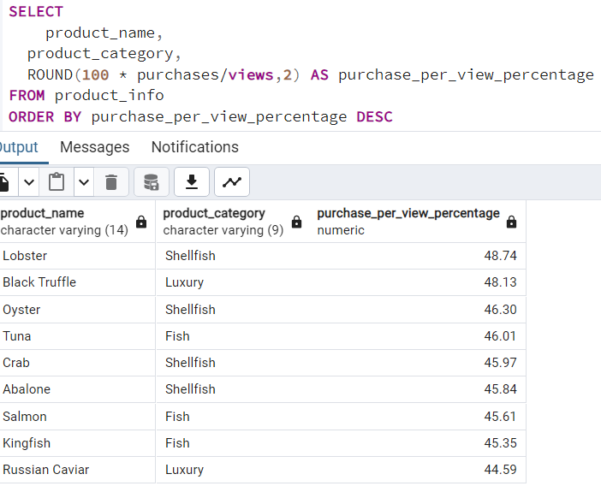
3. Which product had the highest view to purchase percentage?
Lobster has the highest view to purchase percentage with a value of 48.74%

Slide 18
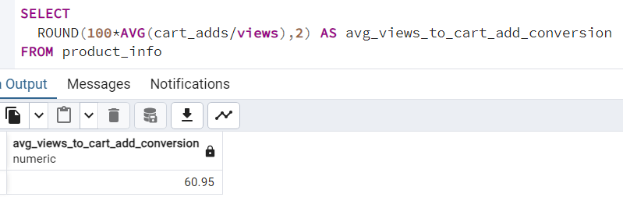
4. What is the average conversion rate from view to cart add?

Slide 19
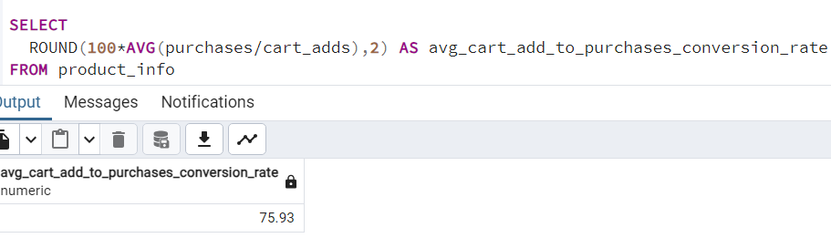
5. What is the average conversion rate from cart add to purchase?

Slide 20
4. Campaigns Analysis
Generate a table that has 1 single row for every unique visit_id record and has the following columns:
user_id
visit_id
visit_start_time: the earliest event_time for each visit
page_views: count of page views for each visit
cart_adds: count of product cart add events for each visit
purchase: 1/0 flag if a purchase event exists for each visit
campaign_name: map the visit to a campaign if the visit_start_time falls between the start_date and end_date
impression: count of ad impressions for each visit
click: count of ad clicks for each visit
(Optional column) cart_products: a comma separated text value with products added to the cart sorted by the order they were added to the cart (hint: use the sequence_number)

Slide 21
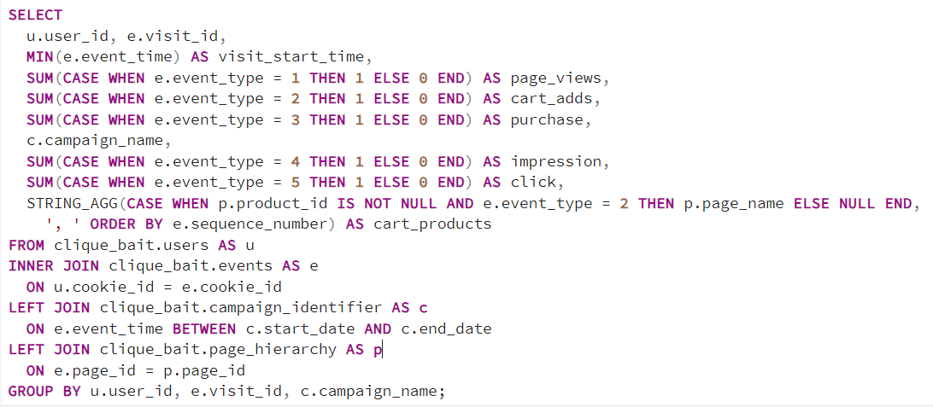
Campaign Analysis Solution

Slide 22
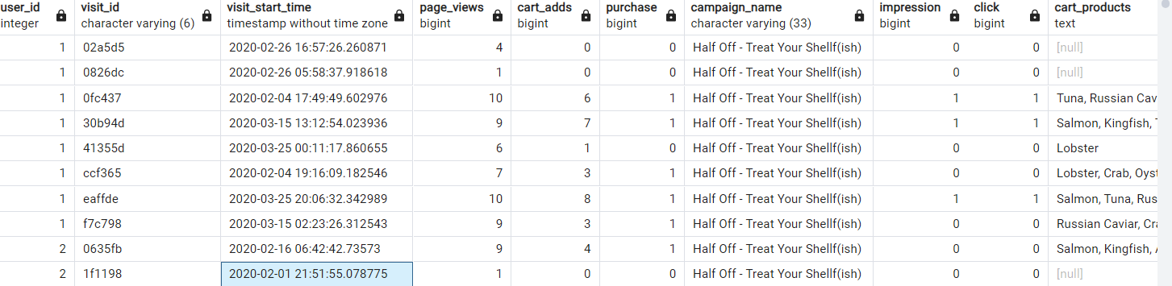
Campaign Analysis Solution Output

